Slide 1

DAISY
Data Analysis and Information SecuritY Lab
Snooping Keystrokes with mm-level Audio Ranging on a Single Phone
Presenter: Jian Liu
Jian Liu†, Yan Wang†, Gorkem Kar #, Yingying Chen†,
Jie Yang‡, Marco Gruteser#
†Dept. of ECE, Stevens Institute of Technology, USA
# Winlab, Rutgers University, USA
‡ Dept. of CS, Florida State University, USA
MobiCom 2015
Paris, France
Sep. 9 – 11, 2015
Notes:
1

Slide 2
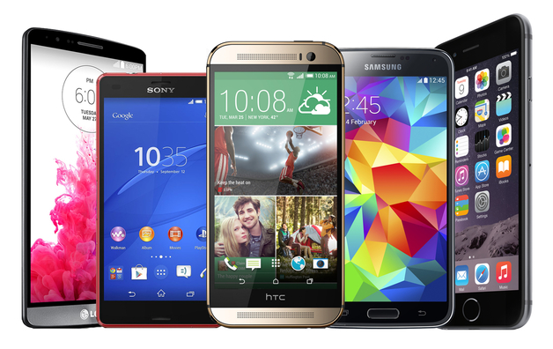

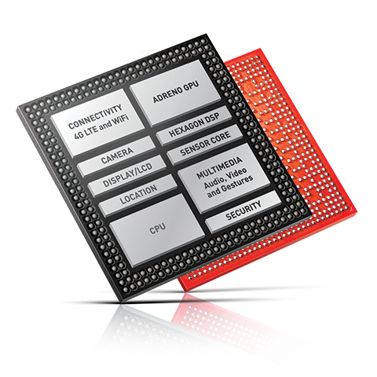
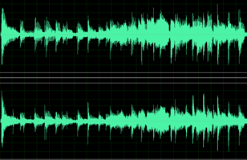
Mobile Device Hardware Advancements
High definition audio capabilities targeted at audiophiles
  Microphone arrays (stereo recording & noise canceling)
  4x improvement in audio sampling rates
  Such advancements have security concerns
Mic-1
Stereo recording
Audio chipset: 192kHz playback and recording
Mic-2
Mic-3

Slide 3
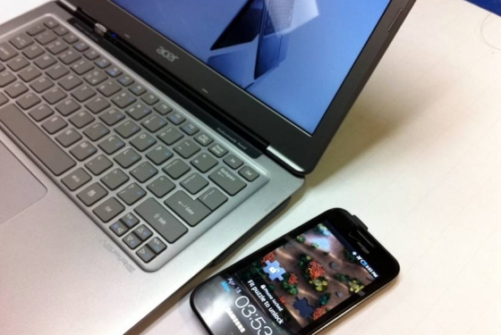
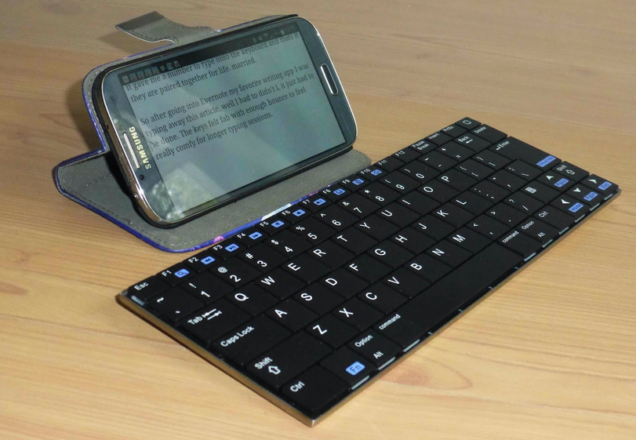

The Results of the Advancements
Facilitating fine-grained localization based applications
  Tracking speakers in multiparty conversations
  Sensing touch interaction on surfaces around mobile devices
Eavesdropping keystrokes without suspicion
  Adding malware into the target user’s phone with microphone access
  Leaving a phone near a keyboard of the target user
Adding malware with Mics access
Leaving a phone

Slide 4



Be careful of these nearby phone!
They can hear your typing!

Slide 5
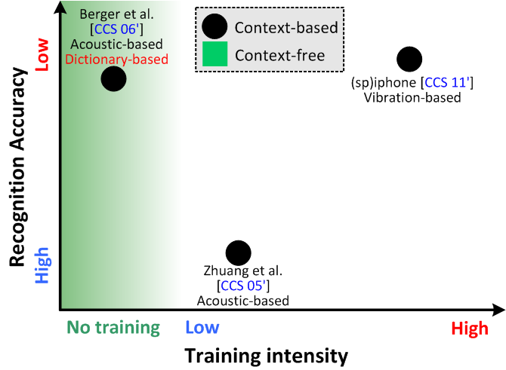
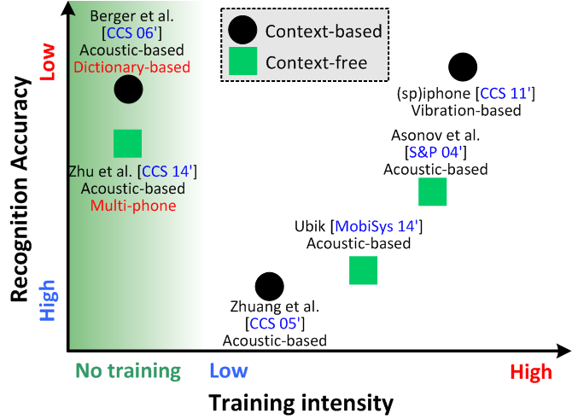
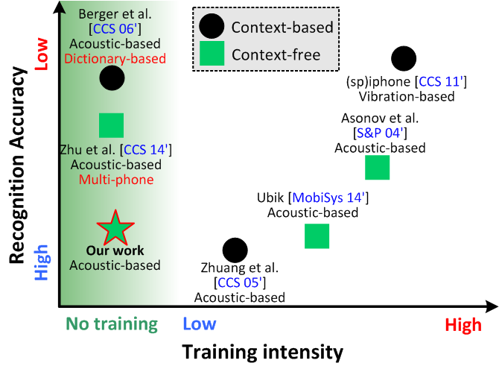
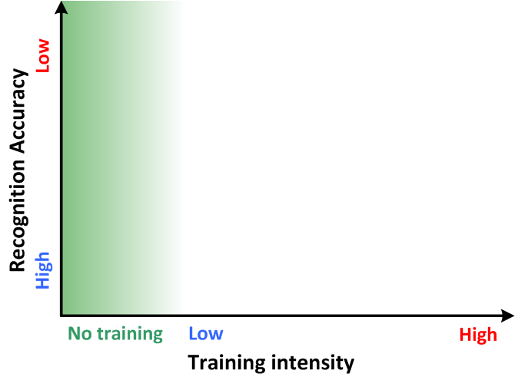


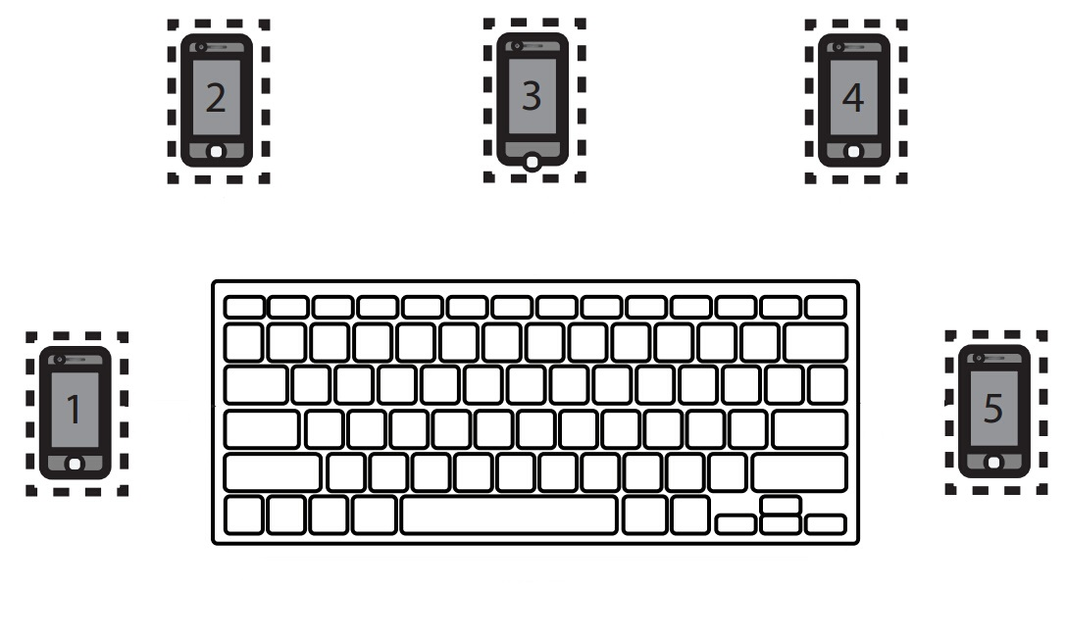
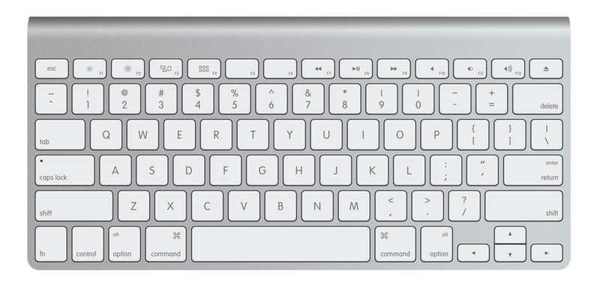
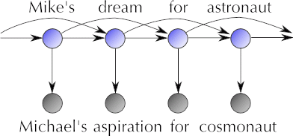
Related Work
Label each key for training
Multiple recording devices
Linguistic context
Training with labeled data
Multi-phone to be placed around
require a-priori labeled training data
typing has to satisfy English language pattern

Slide 6







Our Approach
No linguistic model
No labeled training
(e.g., without any cooperation of the target user)
No involvement of multiple phones

Slide 7
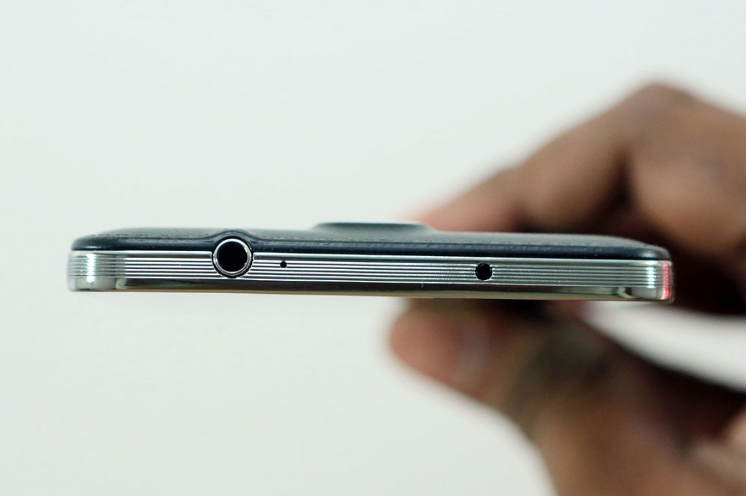
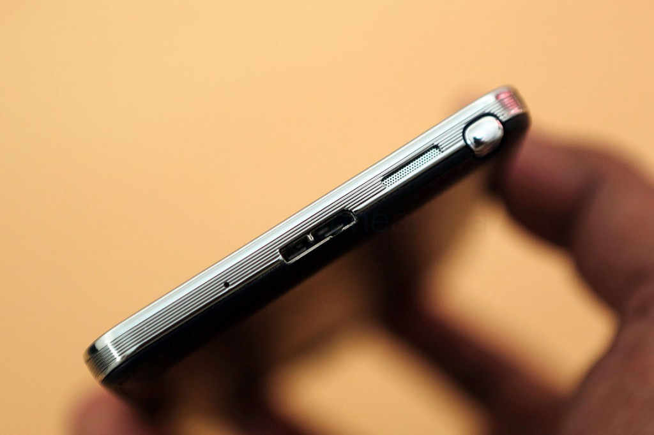
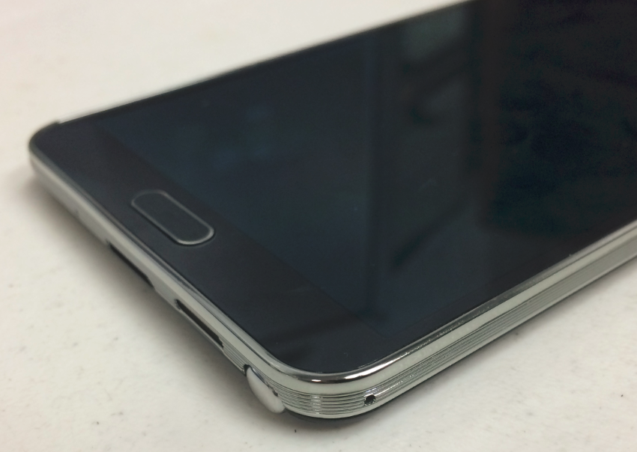

Available Audio Components in a Single Phone
  Stereo recording of two microphones
  High sampling rate
Stereo 1
Mic1
Stereo 2
Noise Cancellation
Stereo recording
Mic3
Mic2

Slide 8


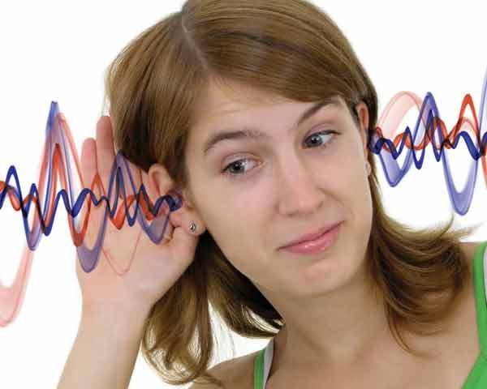
What can we obtain from the dual-Mic in a phone to snoop keystrokes?

Slide 9

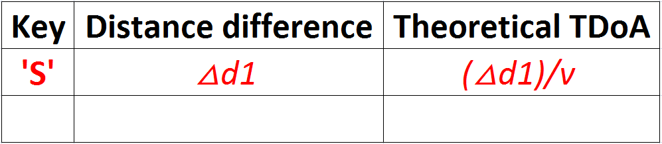
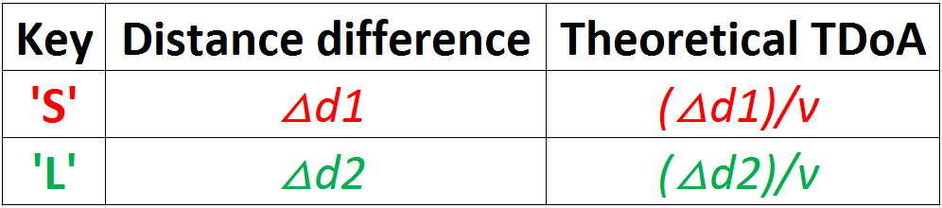
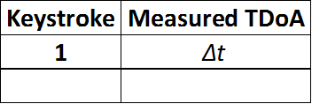
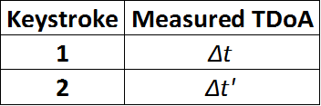


Feature 1: Time Difference of Arrival (TDoA)
Theoretical TDoA
Mic1
Measured TDoA
Distance difference Δd1
t1=t
Mic2
Distance difference Δd2
t1=t’
t2=t+Δt
t2=t’+Δt’
`
S
L
Most of the keys could be differentiated by the TDoAs

Slide 10
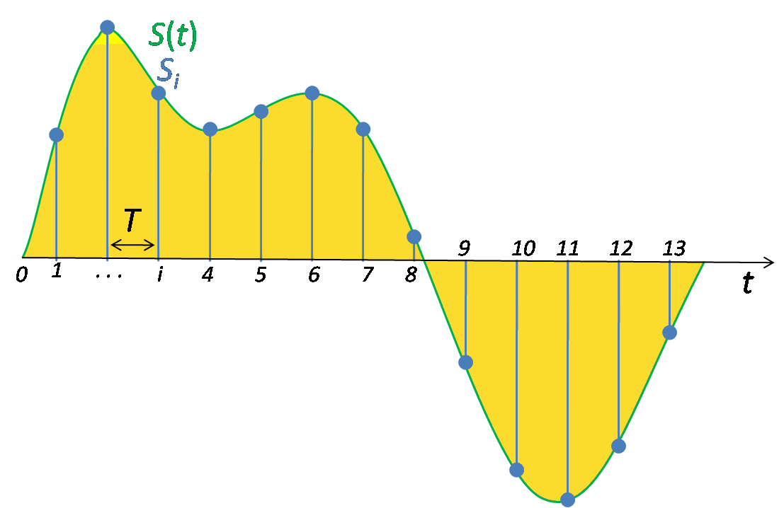
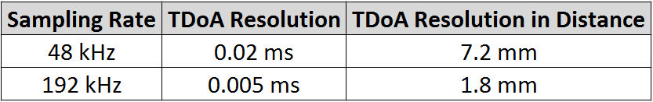
Limits of Measured TDoA
Dual-Microphone TDoA can only identify a group of keystrokes
TDoA = Δt
r1 – r2 = Δt·v
Measured TDoA has the Resolution Limited by Sampling Rate
Sampling by ADC
Speed of sound: 343m/s

Slide 11
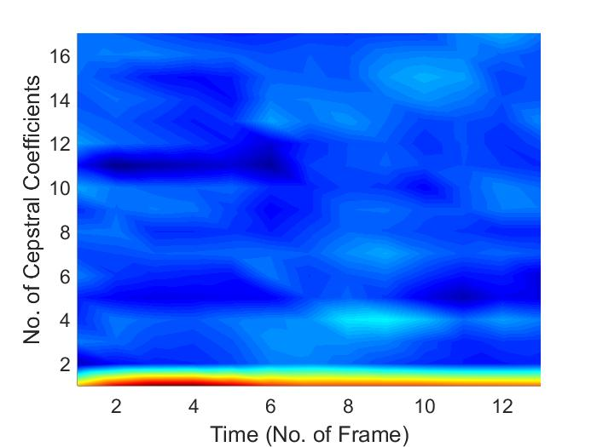
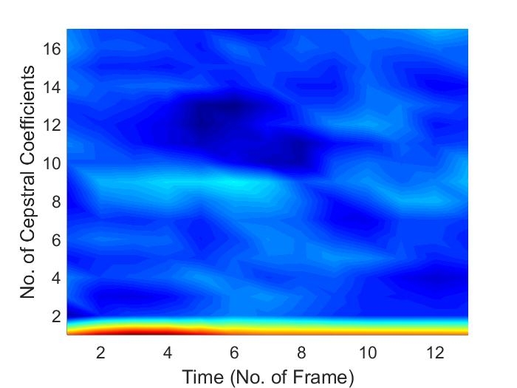
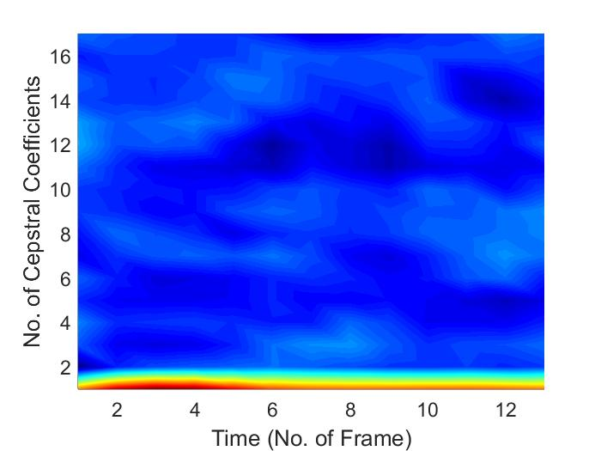
Feature 2: Acoustic Signature
Keystrokes of different keys sound different
MFCCs (Mel-frequency Cepstral Coefficients) can be used to discriminate sounds of different keys
MFCC of key ‘E’
MFCC of key ‘D’
MFCC of key ‘X’

Slide 12

We can combine TDoA and acoustic signatures to identify each keystroke！

Slide 13
System Overview
A Set of Keystrokes
Keystroke Detection & Segmentation
TDoA Derivation
Key Groups Generation
Grouping of Keystrokes
Theoretical Key Groups
Acoustic Signature Extraction
MFCC-based Clustering with in a Group
Theoretical TDoA
Cluster-based Letter Labeling
Identified Keystrokes

Slide 14
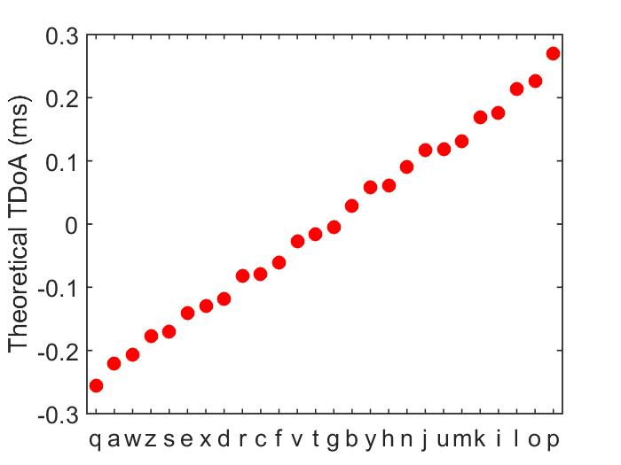
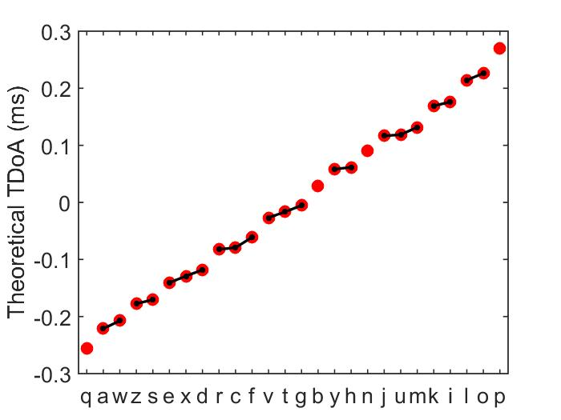

Theoretical Key Groups
A theoretical key group – keys having similar theoretical TDoAs
Link any pair of keys whose theoretical TDoAs are too similar
Sorting
Q
W
E
R
T
Y
U
I
O
P
A
S
D
F
G
H
J
K
L
One theoretical key group
Z
X
C
V
B
N
M

Slide 15
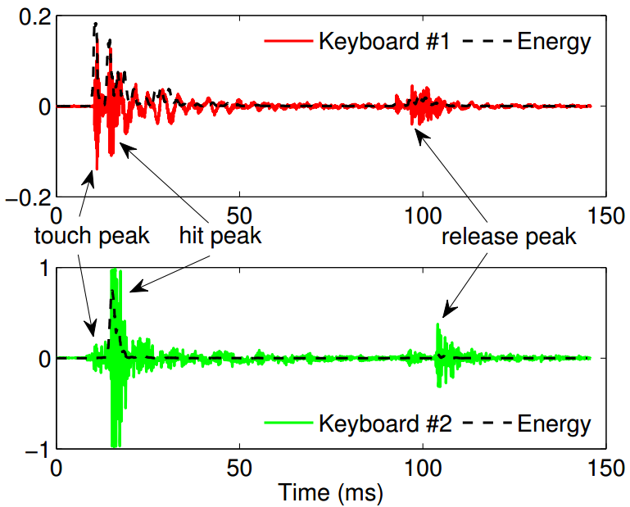

Keystroke Grouping
[sp − 5ms, sp + 100ms], where sp is starting point
Input keystrokes
A Set of Keystrokes
Cross-correlation approach
Keystroke Detection & Segmentation
TDoA Derivation
Grouping of Keystrokes
Theoretical Key Groups
g₁
g₂
g₃
g_{n}
Theoretical key groups

Slide 16
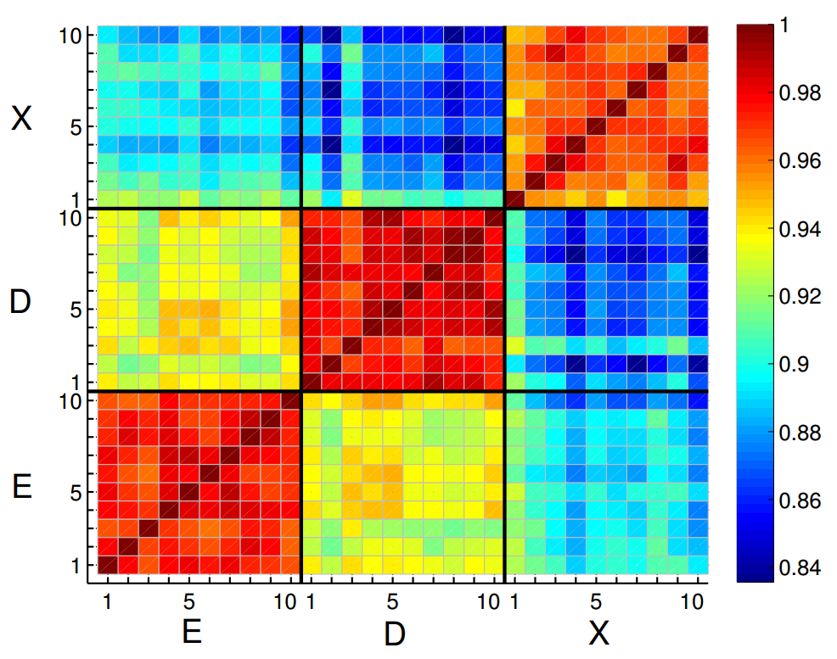
Clustering within Each Group & Labeling
Keystroke clusters
Acoustic Signature Extraction
MFCC-based Clustering with in a Group
Theoretical TDoA
Cluster-based Letter Labeling
Each cluster contains keystrokes of the same key
Identified Keystrokes
clustering
Mean TDoAs
MFCC features: same key shows higher correlation, while different keys present lower correlation
Finding Minimum Distance
Theoretical TDoA
A theoretical key group:
keystrokes of multiple keys with similar TDoAs
E
D
X
Labeling

Slide 17
Evaluation
How robust is the system recovering keystrokes from different keyboards?
What is the performance with different sampling rates?
How does the placement of the phone influence the snooping accuracy?

Slide 18
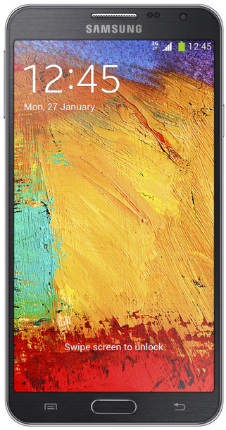
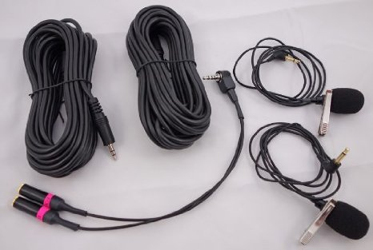
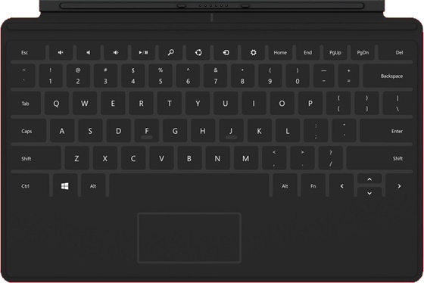
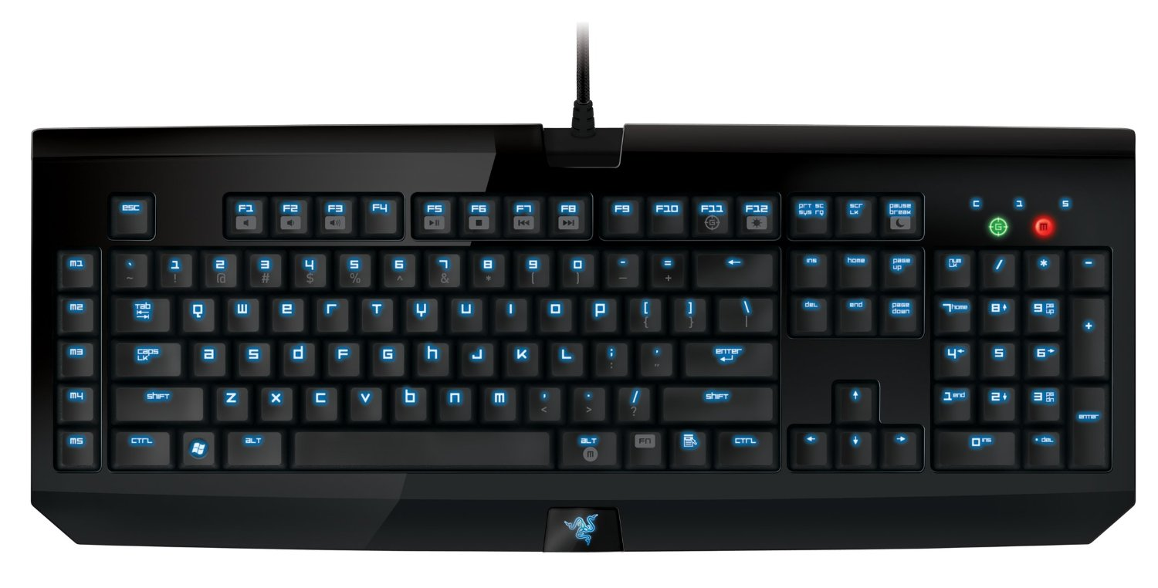
Experimental Setup
Phone/Recording Device
  Samsung Galaxy Note 3 (48kHz)
  External microphones (96/192kHz)
Keyboards
  Three keyboards with different keystroke sound intensity levels
15.3cm
  Apple MC184LL/A
  Microsoft Surface
  Razer Black Widow Ultimate

Slide 19
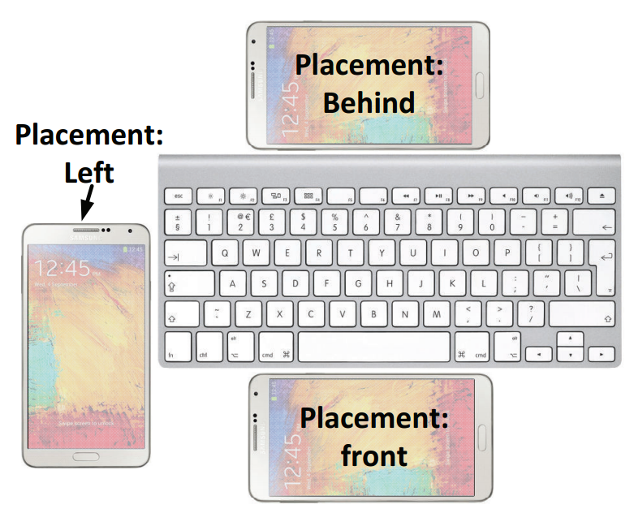
Experimental Setup
Data collection
  Randomly type the 26 keys a-z on keyboards
  In typical office environments with ambient noise (e.g., heater, air-conditioner)
  3,640 keystrokes are collected
Placements
Three typical placements
Evaluation Metric
Top-k Accuracy
- identify k candidate keys for each keystroke
- whether the pressed keys are among identified key candidates

Slide 20
Overall Performance
Top-k Accuracy
Average Accuracy
  Average Top-1 Accuracy: 86%
  Average Top-2 Accuracy: 95%
  Average Top-3 Accuracy: 98%
All three keyboards have comparable high accuracies

Slide 21
Impact of Sampling Rates
Top-k Accuracy
Sampling Rate (kHz)
Top-1 Accuracies
  48kHz: 85%
  96kHz: 86%
  192kHz: 94%
Higher sampling rate improves the recognition accuracy

Slide 22
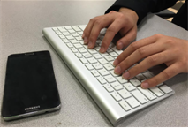
Conclusion
Show that a single phone can recover keystrokes by exploiting mm-level TDoA ranging and fine-grained acoustic features
Develop a training-free approach on a single phone that does not require a linguistic model to snoop keystrokes
Extensive experiments with different keyboards & microphones sampling rates demonstrate that our work could achieve sufficient accuracy for keystroke snooping

Slide 23



DAISY
Data Analysis and Information SecuritY Lab
Thank you!
Jian Liu
jliu28@stevens.edu
http://personal.stevens.edu/~jliu28/

